Slide 1
Software Testing

Slide 2
What is a Software
set of instructions or programs that tell a computer what to do
It enables users to interact with the hardware
Types of software:
System Software - Controls and manages hardware operations; Acts as a bridge between hardware and user applications. Ex: OS, Device drivers, BIOS, etc.
Application Software - Designed to perform specific tasks for users; Runs on top of system software. Ex: MS Office, web browsers, IDE, games, etc.

Slide 3
What is Software Testing
process of evaluating a system or its components to find whether it meets the specified requirements
It helps identify bugs, errors, or missing requirements
It can be either done manually or using automated tools​

Slide 4
Why is Testing Important
Ensures Quality: Testing helps ensure that the software product is of high quality and performs reliably under all expected conditions.​
Detects Defects Early: It identifies bugs and issues early in the development cycle, reducing the cost and effort of fixing them later.​
Validates Functionality: Confirms that the software behaves as intended and meets the business and technical requirements.​
Improves User Experience: Helps deliver a smooth and bug-free experience, enhancing customer satisfaction.​
Ensures Security: Testing uncovers vulnerabilities and security flaws to prevent potential data breaches and attacks.​
Supports Continuous Improvement: Provides feedback to developers for continuous product enhancements.​
Compliance & Standards: Helps meet regulatory or industry standards, especially in domains like finance, healthcare, and aviation.​

Slide 5
What Happens when you don’t do Proper Testing
Boeing 737 MAX Crashes (2018–2019)
What happened: Two fatal crashes (Lion Air and Ethiopian Airlines) killed 346 people.
Cause: Faulty software in the MCAS system repeatedly forced the plane’s nose down.
Impact: Global grounding of the 737 MAX fleet and billions in losses for Boeing
Ariane 5 Rocket Explosion (1996)
What happened: The European Space Agency’s Ariane 5 rocket self-destructed 37 seconds after launch.
Cause: A software bug caused a 64-bit floating-point number to be converted to a 16-bit integer, leading to an overflow error.
Impact: Loss of a $370 million rocket and damage to ESA’s reputation

Slide 6
What Happens when you don’t do Proper Testing
Mars Climate Orbiter Loss (1999)
What happened: NASA lost a $125 million spacecraft.
CrowdStrike Global Outage (July 2024)
What happened: A faulty update from cybersecurity firm CrowdStrike caused widespread system crashes.
Cause: One team used imperial units, another used metric — a software integration failure.
Impact: Complete mission failure due to lack of unit testing and validation.
Cause: A bug in the validation system allowed a flawed update to be released.
Impact: Millions of Windows systems worldwide experienced the “Blue Screen of Death,” affecting airlines, banks, hospitals, and media outlets

Slide 7
What Happens when you don’t do Proper Testing
Toyota Unintended Acceleration (2009–2011)
What happened: Vehicles accelerated without driver input, causing crashes.
Microsoft Azure Outage (2024)
What happened: A misconfigured update caused a major Azure service disruption.
Cause: Software flaws in the electronic throttle control system.
Impact: Over 90 deaths reported; Toyota paid $1.2 billion in settlements.
Cause: Lack of rollback testing and poor deployment validation.
Impact: Downtime for thousands of businesses relying on cloud infrastructure.

Slide 8
Software Quality​
Capability and reliability of s/w product. ​
States how well the requirement are met
Functional Quality: Measures how well the software performs its intended functions. Example: Does a banking app correctly process transactions?
Structural (Non-Functional) Quality: Focuses on internal characteristics like maintainability, performance, and security. Example: Is the code easy to update? Does it handle high traffic?
Process Quality: Evaluates the effectiveness of the development process.Example: Was the software delivered on time and within budget?

Slide 9
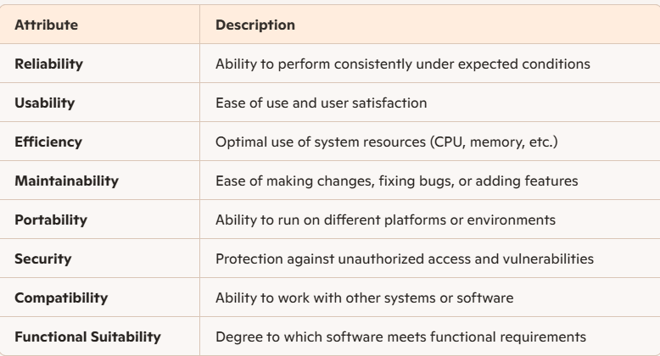
Common Software Quality Attributes

Slide 10
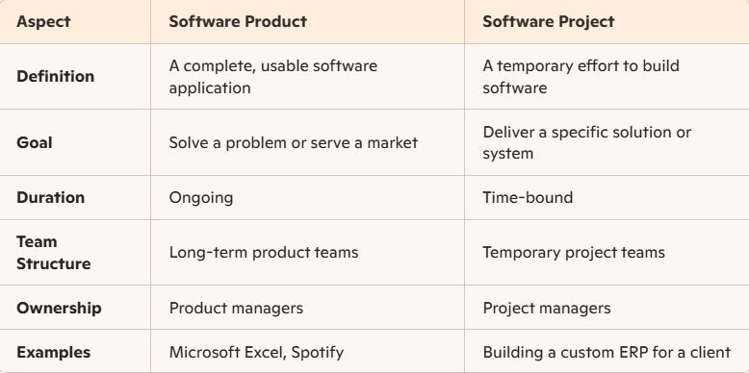
Product Vs Project

Slide 11
Error vs Bug vs Defect vs Failure
Error: A mistake made by people while creating the software. This can happen during various phases, such as planning, designing, writing code, or testing.
Bug: A specific type of fault in software that causes it to not work properly. Typically an error will lead to a bug.
Defect: A general term that includes both errors and bugs. Can be a bug in the code, missing features, things running too slowly, or security vulnerabilities.
Failure: Inability of a system to perform its expected functions. Can be caused by defects in the software.

Slide 12
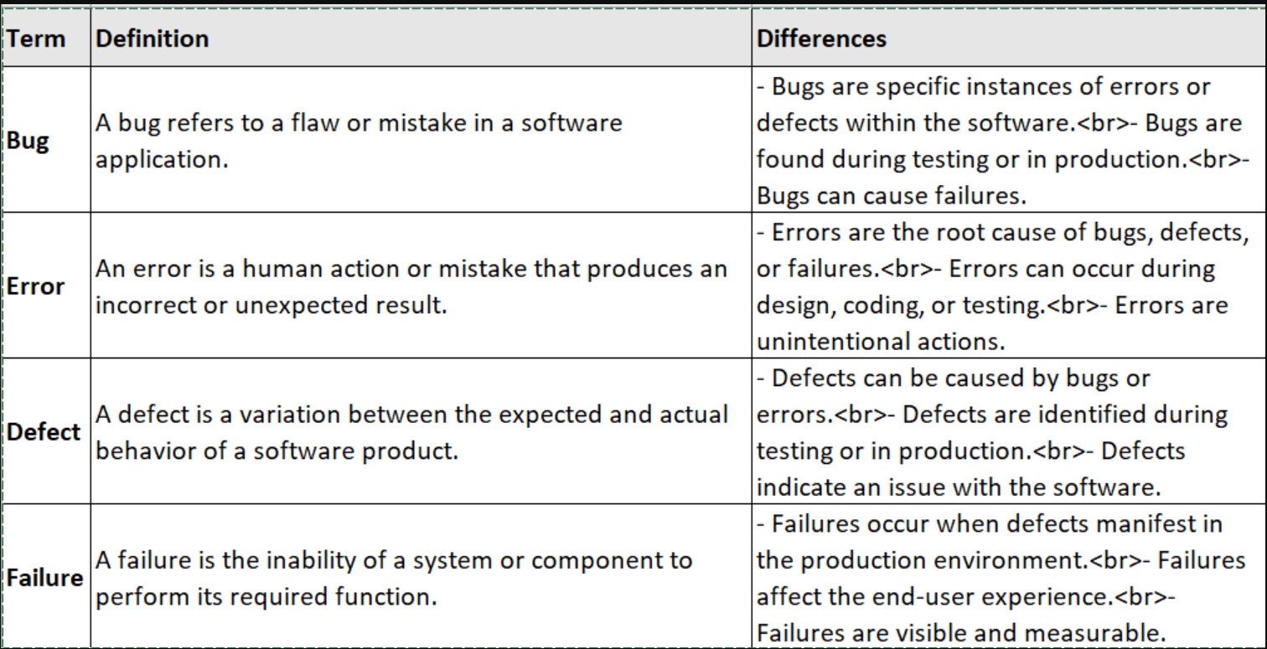

Slide 13
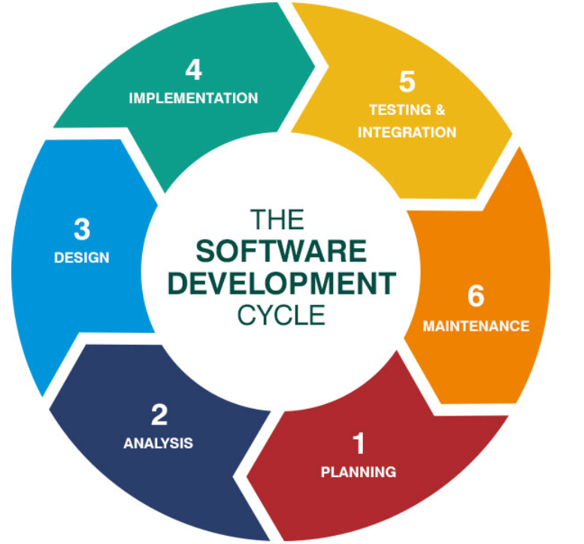
Software Development Lifecycle(SDLC)
A structured process to design, develop, test, and deploy high-quality software efficiently and predictably.
Use different types of development models to perform the given steps

Slide 14
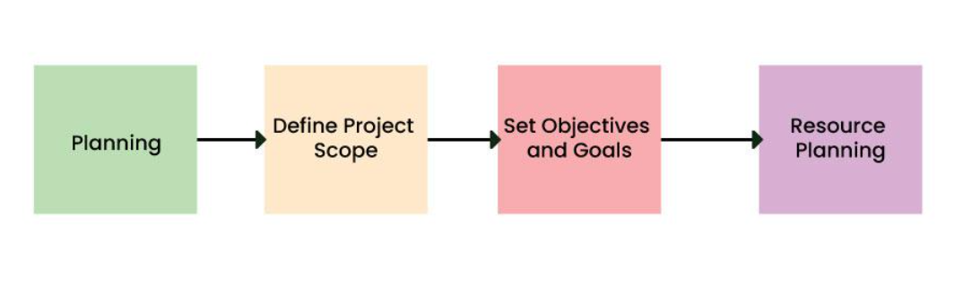
Stage 1: Analysis & Planning
Analyze the objectives, check on the feasibility of the product/project. Define the goals/objectives and other aspects that will be needed to achieve the goals.
Take inputs from different stakeholders related to the product (Customers, sales team, market surveys, SMEs, end users,ect.)

Slide 15
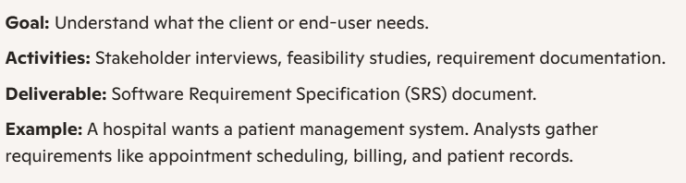
Stage 2: Requirement Gathering & Analysis
Analyze the objectives to decide upon the requirements. Also decide upon the potential risks/downfalls involved.

Slide 16
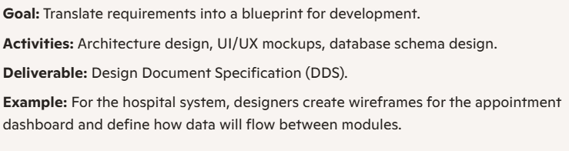
Stage 3 : System Design
Uses the SRS document to come up with the best architecture for the software (Design Document Specification (DDS)).
DDS is assessed by market analysts and stakeholders and the most practical and logical design is chosen for development.

Slide 17
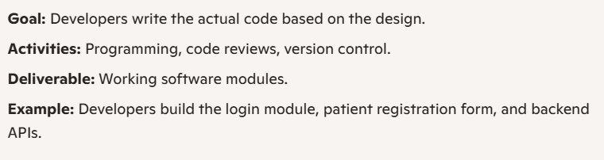
Stage 4: Implementation / Coding
The actual development starts and the product is built. The programming code is generated as per DDS
Developers must follow the coding guidelines defined by their organization and programming tools like compilers, interpreters, debuggers, etc. are used to generate the code.

Slide 18
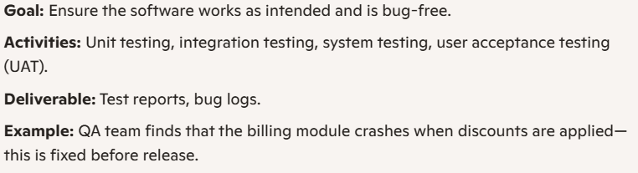
Stage 5: Testing
Testing of the product is performed. Different types of testing will be done to ensure quality
All the probable flaws are tracked, fixed, and retested. This ensures that the product confronts the quality requirements of SRS

Slide 19
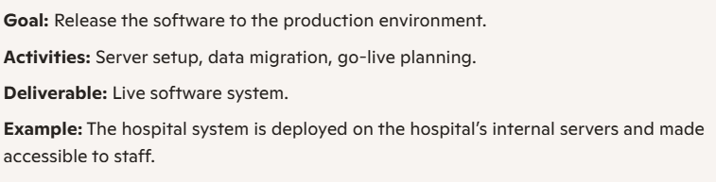
Stage 6: Deployment
Product is released in phases as per the organization’s strategy. Then it is tested in a real industrial environment. If it performs well, the organization sends out the product as a whole.

Slide 20
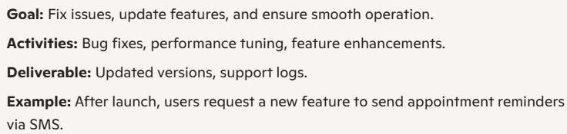
Stage 7: Maintenance and Support
Receives Feedback from end users and stakeholders and work on improvements/changes suggested.
Any new defects identified are fixed and released after testing.

Slide 21
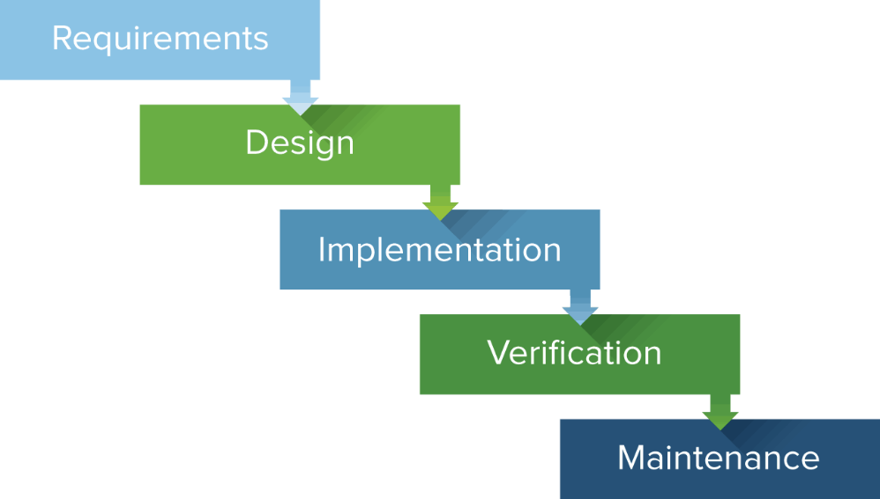
Waterfall Model
A linear and sequential software development methodology
Each phase must be completed before moving to the next
Rigid structure with clearly defined stages
Emphasis on documentation and planning
Minimal client involvement after requirements phase
Best suited for projects with fixed scope

Slide 22
Waterfall Model - Advantages
Simple and easy to understand
Well-suited for small or well-defined projects
Easy to manage due to its structured nature
Early detection of design flaws

Slide 23
Waterfall Model - Disadvantages
Inflexible to changes once development begins
Late discovery of bugs or requirement mismatches
Not ideal for complex or evolving projects
No working software until late in the cycle

Slide 24
Waterfall Model – When to use
Requirements are clear, fixed, and well-documented
Technology is well-understood
Project is short-term and low-risk
Examples:
Government or defense contracts
Legacy system upgrades
Internal tools with fixed scope

Slide 25
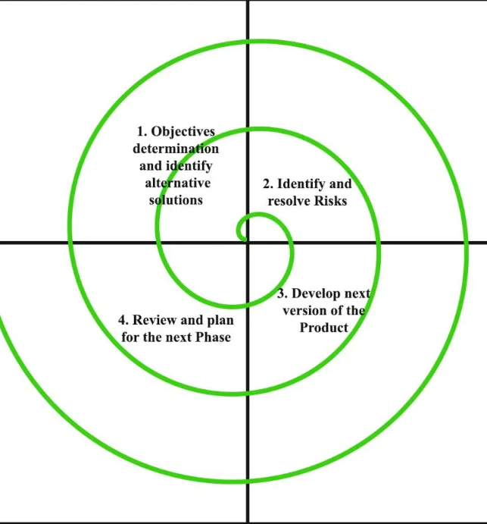
Spiral Model
A software development model that combines elements of Waterfall and Prototyping
Emphasizes risk analysis and iterative refinement
Visualized as a spiral with loops, where each loop represents a development phase
Each loop includes: Planning → Risk Analysis → Engineering → Evaluation

Slide 26
Spiral Model - Advantages
Excellent for large, complex, high-risk projects
Early detection and resolution of risks
Allows for customer feedback at every iteration
Supports incremental releases

Slide 27
Spiral Model - Disadvantages
Can be costly and time-consuming
Requires expertise in risk analysis
Not ideal for small or low-budget projects

Slide 28
Spiral Model – When to use
Projects with unclear or evolving requirements
High-risk applications (e.g., aerospace, defense, banking)
When frequent revisions and prototyping are needed
Large-scale systems requiring continuous refinement

Slide 29
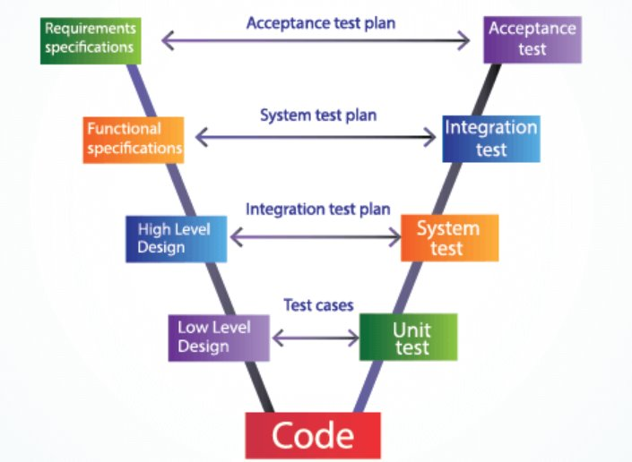
V Model
An extension of the Waterfall model.
It emphasizes verification and validation at each development stage.
Each development phase has a corresponding testing phase.
Suitable for projects with well-defined requirements

Slide 30
V Model - Advantages
Clear structure and documentation
Early test planning improves quality
Easy to manage and track progress
Suitable for safety-critical systems

Slide 31
V Model - Disadvantages
Inflexible to changes once development starts
Not ideal for projects with evolving requirements
No working software until late in the cycle

Slide 32
V Model – When to use
Requirements are clear and fixed
Projects are short to medium in duration
High-reliability systems (e.g., aerospace, automotive, healthcare)
Example: Developing software for a medical device or flight control system

Slide 33
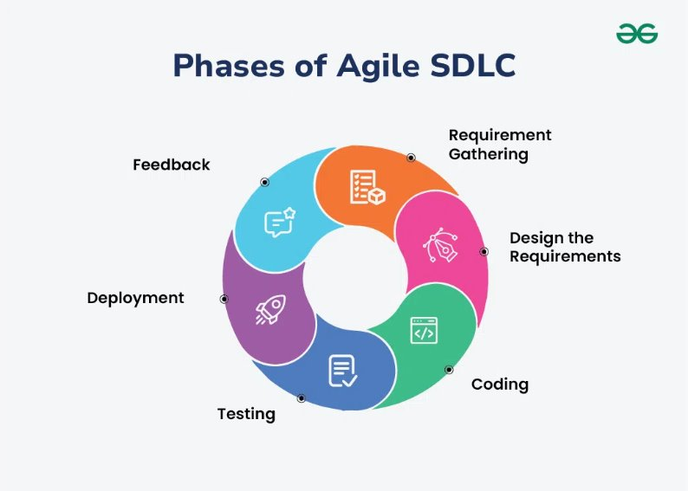
Agile Methodology
Agile is a flexible, iterative approach to software development
Focuses on collaboration, customer feedback, and rapid delivery
Embraces change and encourages continuous improvement
It is easy to adapt the changes when using this model​
Prioritizes the flexibility, collaboration and customer feedback

Slide 34

Agile Manifesto
Core Values:
Individuals and interactions over processes and tools
Working software over comprehensive documentation
Customer collaboration over contract negotiation
Responding to change over following a plan

Slide 35
Agile Principles
Deliver working software frequently
Welcome changing requirements
Business and developers work together daily
Build projects around motivated individuals
Face-to-face conversation is best
Working software is the primary measure of progress
Maintain a sustainable pace
Continuous attention to technical excellence
Simplicity is essential
Self-organizing teams produce best results
Regular reflection and adjustment

Slide 36
Advantages of using Agile
Flexibility and Adaptability
Agile welcomes changing requirements—even late in development.
Teams can pivot quickly based on customer feedback or market shifts.
Faster Time to Market
Working software is delivered in short, frequent iterations (sprints).
Enables early releases and faster value delivery.
Customer Collaboration
Continuous involvement of stakeholders ensures the product aligns with user needs.
Builds trust and improves satisfaction.
Improved Product Quality
Regular testing, code reviews, and retrospectives help catch issues early.
Practices like continuous integration and test automation enhance reliability.
Increased Transparency
Daily stand-ups, sprint reviews, and visible backlogs keep everyone informed.
Promotes accountability and shared ownership.
Higher Team Morale
Self-organizing teams have autonomy and ownership over their work.
Encourages creativity, motivation, and collaboration.
Risk Reduction
Frequent releases and feedback loops help identify and address risks early.
Reduces the chance of large-scale project failure.

Slide 37
Disadvantages of using Agile
Lack of Predictability
Difficult to estimate time, cost, and scope upfront.
May be challenging for fixed-budget or fixed-deadline projects.
Requires Experienced Teams
Agile relies on skilled, self-disciplined team members.
Inexperienced teams may struggle with autonomy and decision-making.
Scope Creep Risk
Continuous changes can lead to uncontrolled expansion of scope.
Requires strong product ownership and backlog management.
Limited Documentation
Agile values working software over comprehensive documentation.
Can be problematic for regulated industries or future maintenance.
Not Ideal for Small Projects
The overhead of Agile ceremonies may outweigh benefits for very small teams or short-term tasks.
Dependency on Customer Availability
Agile requires frequent input from stakeholders.
Lack of engagement can derail progress or lead to misaligned outcomes.

Slide 38
Agile Frameworks - Scrum
used to develop, deliver, and sustain complex products—especially in software development
emphasizes collaboration, adaptability, and iterative progress through short, focused work cycles called Sprints
Think of it like a sports team huddling up, planning the next play, executing it, and then regrouping to improve before the next round

Slide 39
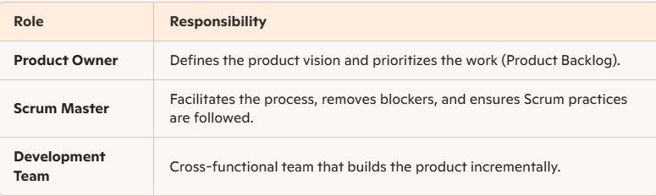
Scrum Components

Slide 40
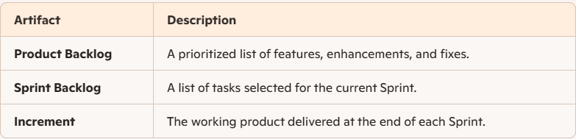
Scrum Artifacts

Slide 41
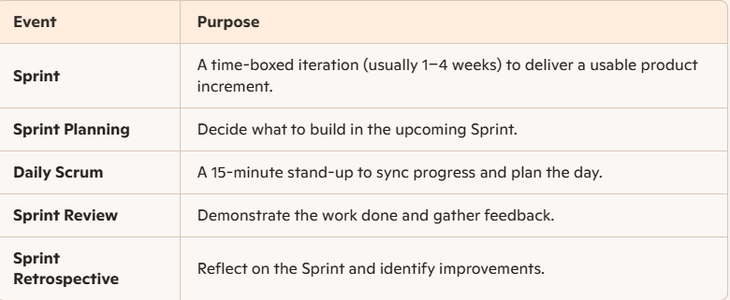
Scrum Ceremonies

Slide 42
Kanban
A visual workflow management method that helps teams manage tasks efficiently by focusing on continuous delivery, limiting work in progress (WIP), and improving flow
originated from Toyota’s production system and has since been adapted for software development, IT operations, marketing, and more.

Slide 43
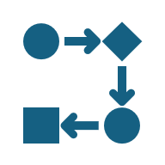
Kanban Core Principles
Visualize the Workflow
Use a Kanban board with columns like “To Do,” “In Progress,” and “Done.”
Tasks are represented as cards that move across the board.
Limit Work in Progress (WIP)
Set a maximum number of tasks allowed in each stage.
Helps prevent overload and ensures focus.
Manage Flow
Track how tasks move through the system.
Aim for a smooth, predictable flow of work.
Make Process Policies Explicit
Clearly define rules for how work moves between stages.
Implement Feedback Loops
Regular reviews and stand-ups help teams adapt and improve.
Improve Collaboratively, Evolve Experimentally
Use data and feedback to continuously refine the process.

Slide 44
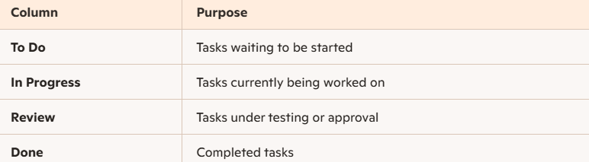
Kanban Board

Slide 45
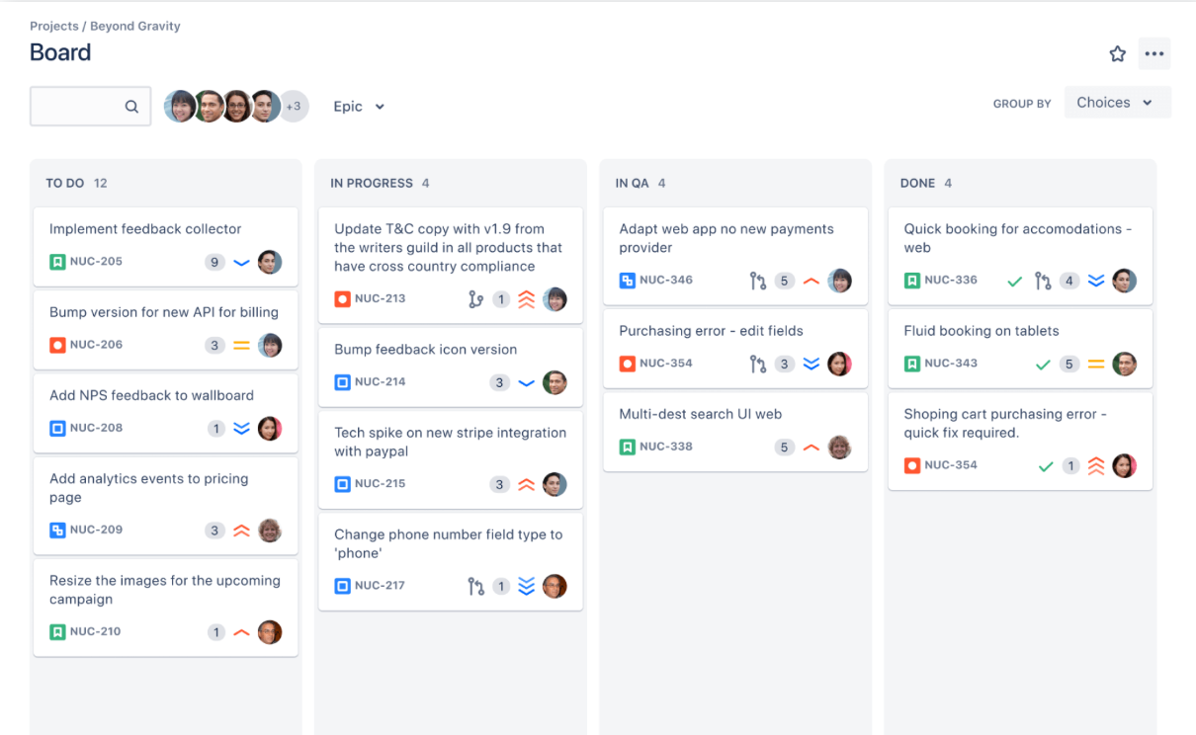

Slide 46

Agile Atrifacts and Standards - Product Backlog
Ordered list of everything needed in the product
Dynamic, evolving document maintained by Product Owner
Includes: features, enhancements, bug fixes, technical work, knowledge acquisition
Goal: Ensure team works on the most valuable items

Slide 47
Why Prioritization Matters
Aligns development with business goals
Maximizes ROI by focusing on high‑value items
Helps manage limited resources effectively
Provides transparency to stakeholders

Slide 48
Prioritization Models Overview
Value vs. Effort Matrix - Plot backlog items on 2x2 grid (High/Low Value vs. High/Low Effort)
MoSCoW Method – Segregate backlog items into Must Have, Should Have, Could Have and Won’t Have (this time) categories.
Kano Model – Sort into categories: Basic Needs (expected features), Performance Needs (improve satisfaction proportionally), Excitement Needs (delight users unexpectedly).
WSJF (Weighted Shortest Job First) – Items sorted in terms of Business Value, Time Criticality, Risk Reduction / Opportunity Enablement; WSJF = Cost of Delay ÷ Job Size

Slide 49
Prioritization Models Overview
Cost of Delay - Quantify economic impact of not delivering a feature (User dissatisfaction, Lost revenue, Increased operational costs, etc.)
RICE Scoring - RICE = (Reach × Impact × Confidence) ÷ Effort
Reach: How many users affected
Impact: Degree of benefit
Confidence: Certainty of estimates
Effort: Resources required

Slide 50
Agile Atrifacts – User Stories
Short, simple descriptions of a feature told from the perspective of the user
Format: As a [role], I want [feature], so that [benefit]
Purpose: Capture requirements in a lightweight, collaborative way
Example: As a shopper, I want to filter products by price so that I can find affordable items

Slide 51
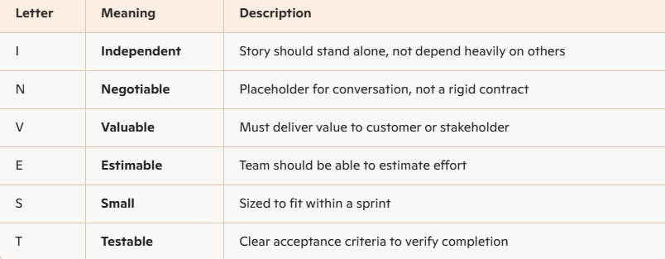
User Stories - INVEST Model
Checklist to evaluate quality of user stories
Ensures backlog items are: clear, actionable, and valuable
Helps avoid vague, oversized, or dependent stories

Slide 52
Context | Description | Good Example | Bad Example
Independent | Story should stand alone, not depend heavily on others | As a user, I can reset my password via email. | “As a user, I can reset my password after the new login system is built.” (depends on another story)
Negotiable | Placeholder for conversation, not a rigid contract | “As a shopper, I want to filter products by price range.” (open to discussion on UI/UX) | “System must have a dropdown with fixed ranges: $0–$50, $51–$100, $101–$200.” (too rigid, no room for collaboration)
Valuable | Must deliver value to customer or stakeholder | “As a customer, I want to track my order status online.” (direct business value) | “Add a hidden debug log for developers.” (no stakeholder value)
Estimable | Team should be able to estimate effort | “As a user, I want to receive email notifications for new messages.” (clear scope, easy to estimate) | “Improve system performance.” (too vague, cannot estimate)
Small | Sized to fit within a sprint | “As a user, I want to upload a profile picture.” (fits in one sprint) | “As a user, I want a complete social networking platform.” (too large, needs splitting)
Testable | Clear acceptance criteria to verify completion | “As a user, I want to log in with my email and password, so that I can access my account.” | “System should be user‑friendly.” (not testable, subjective)

Slide 53
Acceptance Criteria
Conditions that a user story must satisfy to be considered complete
Purpose:
Define scope and boundaries of a story
Provide clarity to developers and testers
Ensure alignment with business needs
Importance of Acceptance Criteria:
Acts as a contract between Product Owner and Development Team
Guides development and testing
Helps avoid scope creep
Provides objective measure of “Done”

Slide 54
Given‑When‑Then Format Overview
Given: Initial context or precondition
When: Action or event performed
Then: Expected outcome or result
Good Acceptance Criteria:
User Story: As a user, I want to reset my password so that I can regain access to my account.
Acceptance Criteria (Given‑When‑Then):
Given the user is on the login page
When the user clicks “Forgot Password” and enters a valid email
Then the system sends a password reset link to that email

Slide 55
Bad Acceptance Criteria
User Story: As a user, I want to reset my password.
Acceptance Criteria: “System should allow password reset.”
Problem:
No context, no action, no measurable outcome
Cannot be directly linked to a test case

Slide 56
Linking Acceptance Criteria to Test Cases
Process:
Each acceptance criterion becomes a test scenario
QA team derives test cases from Given‑When‑Then steps
Ensures traceability from user story → acceptance criteria → test case → test result
Benefits:
Improves coverage
Reduces missed requirements
Provides audit trail

Slide 57
Example – Linking to Test Cases
Acceptance Criterion:
Given the user enters a valid email
When they request a password reset
Then a reset link is sent
Test Case:
Test ID: TC‑001
Precondition: User has a valid account
Steps:
Navigate to login page
Click “Forgot Password”
Enter valid email
Expected Result: Reset link received in email inbox

Slide 58
Definition of Done (DoD)
Definition: Shared understanding of what “done” means for backlog items
Purpose:
Ensures consistent quality across teams
Provides transparency to stakeholders
Acts as a checklist for completion criteria
Outcome: A story is only “done” when it meets all agreed criteria
Examples:
Code reviewed by peers
Unit tests written and passed
Documentation updated
Feature demoed to Product Owner

Slide 59
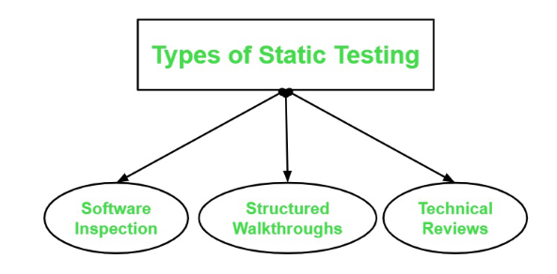
Static Testing
A software testing technique that examines code, documents, and design without executing the program
Focuses on early defect detection during the development lifecycle
Also known as dry-run testing or verification
Usually happens during design and implementation phase

Slide 60
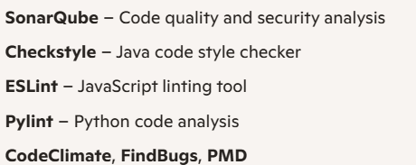
Static Testing
Benefits
Early Detection of Defects​
Cost-effective​
Increased Development Productivity
Limitations
Depends on Reviewer's Skills​
Time-consuming​

Slide 61
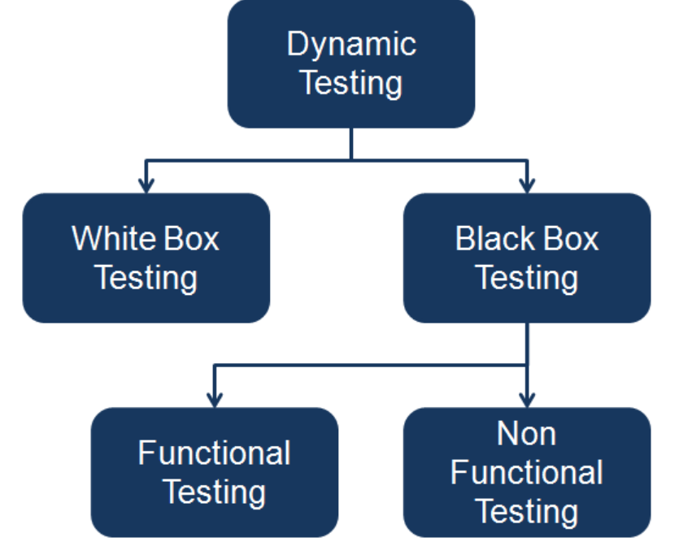
Dynamic Testing
A software testing technique that involves executing the code to validate its behavior
Focuses on runtime verification of functionality, performance, and reliability
Also known as validation testing
Happens during Testing and maintenance phases

Slide 62
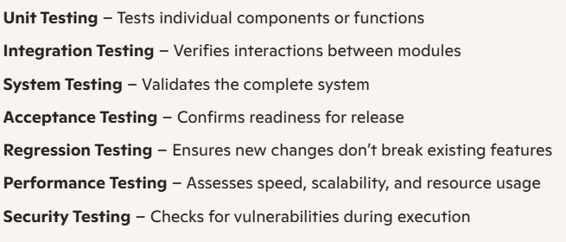
Dynamic Testing
Benefits
Reveals Runtime Errors​
Verifies Integration of Modules​
Accurate Reliability Assessment
Limitations
Time-consuming​
Requires Significant Effort

Slide 63
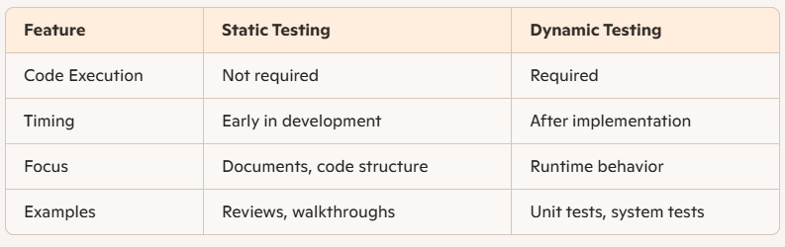

Slide 64
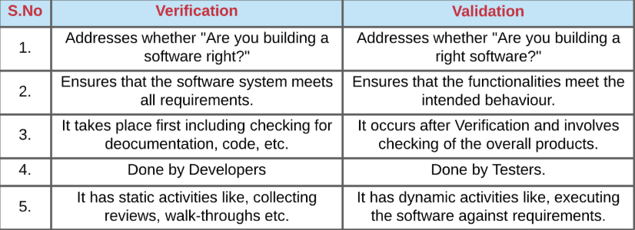
Verification vs Validation

Slide 65
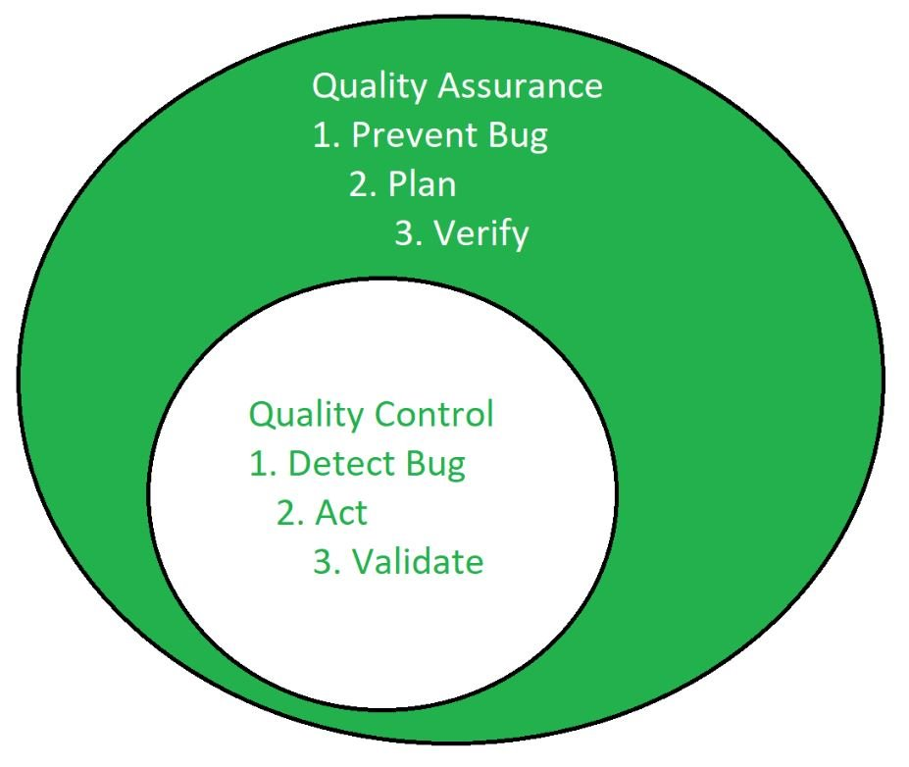
QA vs QC vs QE
Quality Assurance (QA) :​
It is a activity that ensures the approach, techniques, method and processes used to prevent the bug – Systematic approach​
QA includes constant process assessment and improvement
Quality Control (QC) :​
It is a activity/tool used to detect the bug
QC includes monitoring and verifying.
Quality Engineering (QE) :​
It is a advance approach that include both ​QA and QC to prevent the bug​

Slide 66
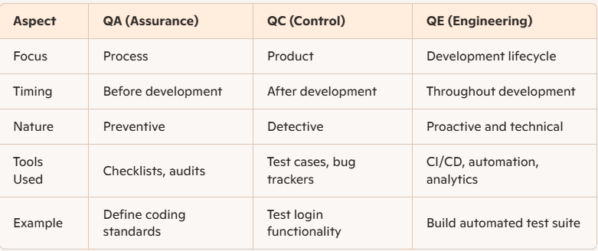

Slide 67
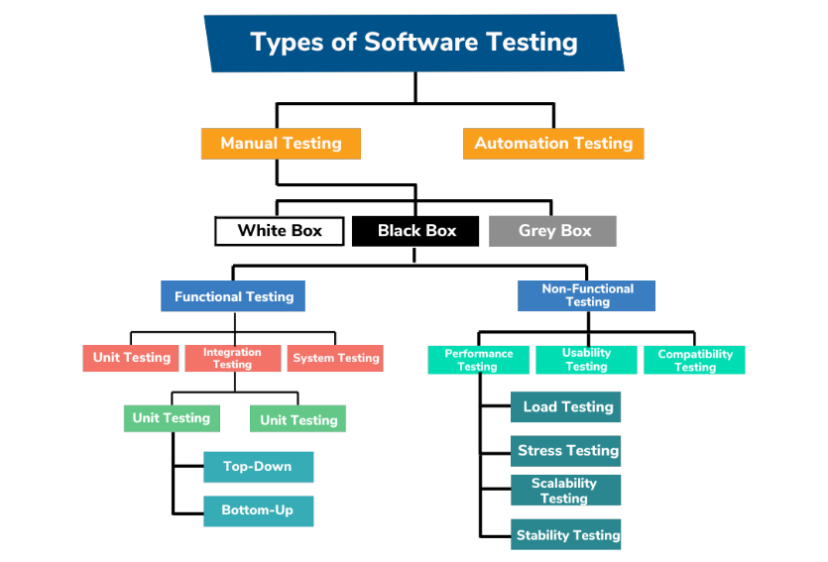
Types of Software Testing

Slide 68
Types of Testing
Unit Testing: ​
In this type of testing, errors are detected individually from every component or unit. ​
Usually done by the developers
Integration Testing:​
In this testing, two or more modules which are unit tested are integrated to test i.e., technique interacting components and then verified
System Testing: ​
In system testing, complete and integrated software(s) are tested i.e., all the elements forming the system are tested as a whole to meet the requirements

Slide 69
Types of Testing
User Acceptance Testing (UAT) : ​
This is a kind of testing conducted to ensure that the requiremenare fulfilled before its delivery and that the software works correctly in the user’s working environment
Performance Testing: ​
Assesses how the system behaves under varying loads and conditions
Usability Testing: ​
Evaluates the ease of use and user-friendliness of the system
Security Testing: ​
Checks for vulnerabilities, ensuring the system is secure from threats and unauthorized access

Slide 70
Types of Testing
Compatibility Testing
Ensures the system works seamlessly across different environments, such as operating systems and devices
Regression Testing
Tests the system after changes or updates to confirm that previously working functionalities are not affected
Retesting
This is done to verify - specific defects have been fixed in the system or to check the repeatability
It focuses solely on the areas where bugs were reported

Slide 71
Types of Testing
Exploratory Testing: ​
This approach is unscripted and relies on the tester's creativity, experience, and intuition
Testers explore the application in real-time, identifying unexpected behaviour or issues without predefined test cases
Smoke Testing: ​
Known as the "sanity check," smoke testing is a preliminary test conducted to ensure the most basic and critical functionalities of the system work properly
If the smoke test fails, the system isn't stable enough for further testing

Slide 72
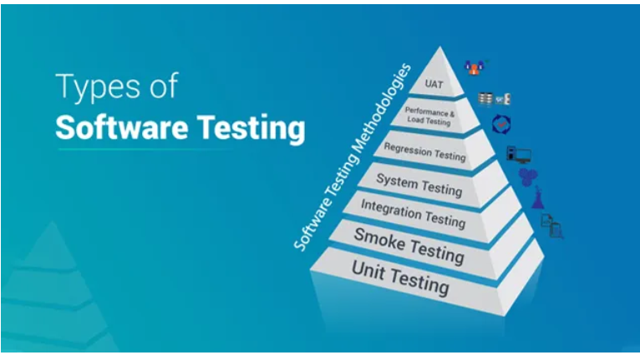

Slide 73
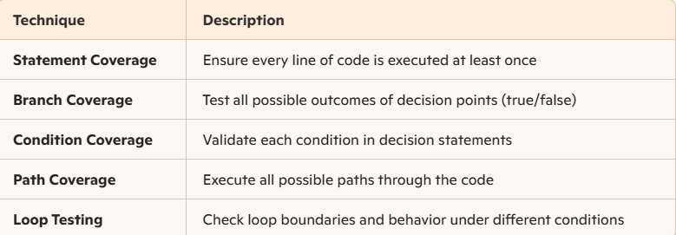
Testing Techniques – White Box Testing
involves testing the internal structure, logic, and code of the application
Requires programming knowledge and access to the source code
Ensure code paths, conditions, and loops behave correctly
Detect logic errors, security vulnerabilities, and inefficient code
Improve code quality and maintainability
Used during unit and integration testing

Slide 74
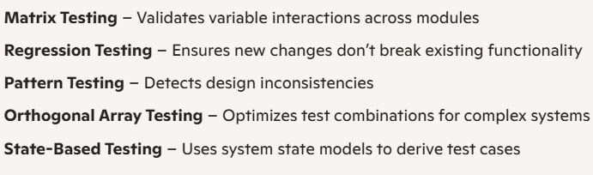
Testing Techniques – Grey box Testing
hybrid testing technique combining aspects of Black Box and White Box testing
Testers have partial knowledge of the internal structure (e.g., architecture diagrams, design documents)
Detect integration-level defects and security vulnerabilities
Validate data flow, input/output handling, and system behavior
Improve test coverage by combining external testing with internal awareness
Used for testing middleware and APIs

Slide 75
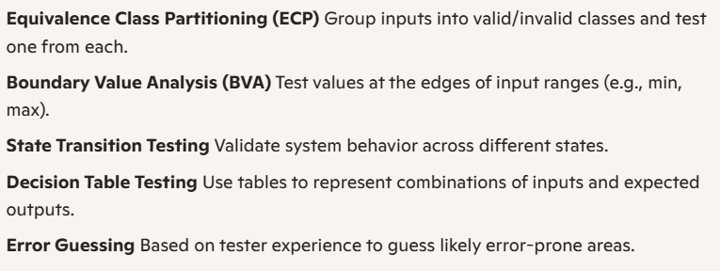
Testing Techniques – Black Box Testing
evaluates the system based on inputs and outputs
Testers do not require knowledge of internal code or architecture
Focuses on functional behaviour from the end-user’s perspective
Validate that the software meets functional requirements
Ensure the system behaves correctly under various input conditions
Identify incorrect or missing functionality
Enhance user experience and reliability

Slide 76
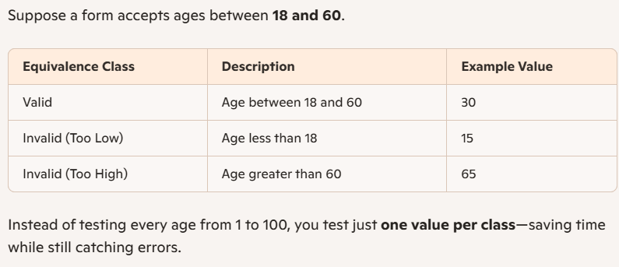
Equivalence Class Partitioning (ECP)
A black-box testing technique used to reduce the number of test cases while maintaining effective coverage.
It works by dividing input data into equivalence classes—groups of inputs that are expected to behave similarly—so you only need to test one value from each class.
How to test:
Identify input conditions (e.g., valid ranges, formats).
Group inputs into equivalence classes:
Valid classes: Inputs that should be accepted.
Invalid classes: Inputs that should be rejected.
Select representative values from each class to test.

Slide 77
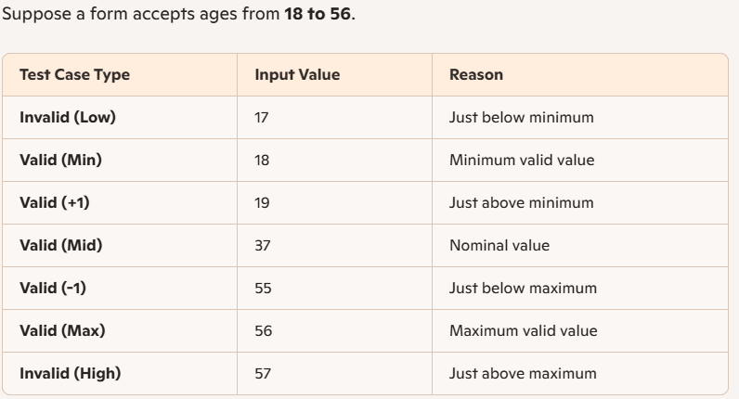
Boundary Value Analysis (BVA)
A black-box testing technique that focuses on testing the edges or boundaries of input ranges—because defects often occur at the extremes rather than in the middle
Instead of testing all possible inputs, BVA targets values at and around the boundaries of valid and invalid input ranges
Complements Equivalence Class Partitioning (ECP) for broader coverage

Slide 78
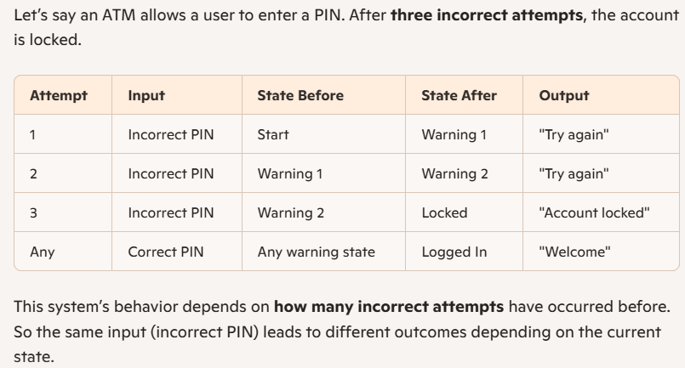
State Transition Testing
It models the system as a finite state machine (FSM)
Each state represents a condition or situation of the system
Transitions occur when events or inputs trigger a change from one state to another
Helps ensure the system behaves correctly across sequences of inputs

Slide 79
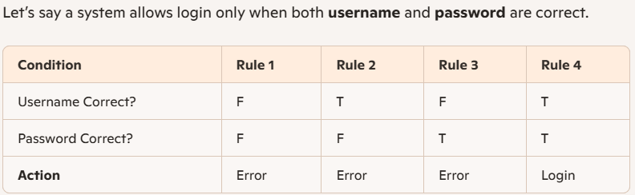
Decision Table Testing
It helps testers systematically cover all possible input combinations
Each row represents a condition or action
Each column represents a rule (a unique combination of inputs)
Often referred to as a Cause-Effect Table, where causes are inputs and effects are outputs

Slide 80
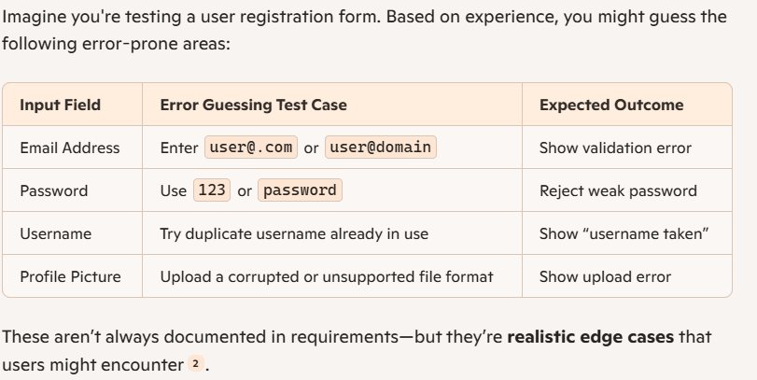
Error Guessing
It’s an informal and creative approach to testing
Testers “guess” where errors might occur based on past experience, common pitfalls, or understanding of user behaviour
Often used to supplement structured techniques like boundary value analysis or decision tables.

Slide 81
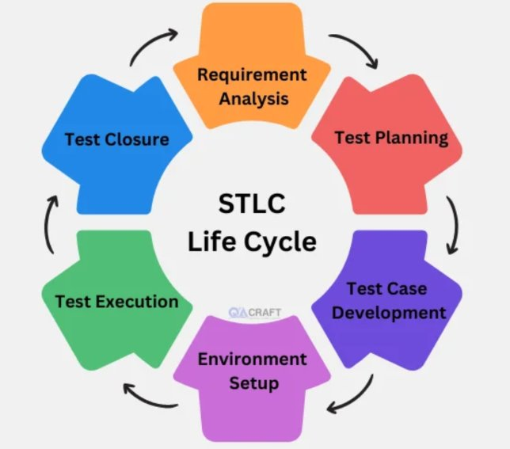
Software Testing Life Cycle(STLC)
Requirement Analysis​
Test Planning​
Test Case Development​
Test Environment Setup ​
Test Execution​
Test Closure​

Slide 82
Phases of STLC
Requirement Analysis:
Requirement provided by client is reviewed and analyzed. If there is any correction or clarification, will be sorted and Requirement Traceability Matrix (RTM) is prepared.
Test Planning:
A Senior QA and managers determines the test strategy/plan, efforts and cost estimates. Also involves preparing the test document, selecting test tools and planning resources
Test Case Development:
Testing team creates, verifies, and reworks test cases and test scripts. Test data is identified, created, and reviewed. The QA team develops test cases for individual units
Test Environment Setup:
Setting up the software and hardware conditions under which the product will be tested. The test team performs a readiness check (smoke testing).
Test Execution:
Testers execute the test cases based on the test plans and scripts prepared. They document test results, log defects for failed cases, and map defects to test cases in the RTM.
Test Cycle Closure:
Involves reporting test completion, collecting test metrics, and analyzing test results. Discussing and analyzing testing artifacts to identify strategies for future improvements

Slide 83
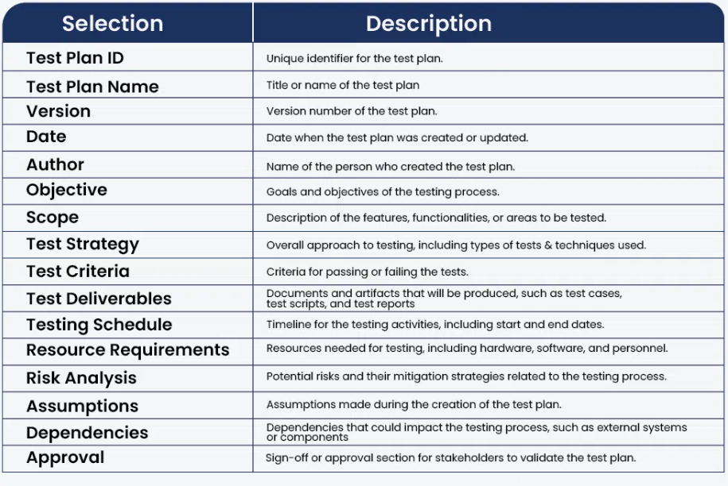

Slide 84
Test Cases
Test Case ID: Unique identifier for tracking Test
Description: Brief summary of what’s being tested
Preconditions: Required setup or initial state before execution
Test Steps: Sequential actions to performTest
Expected Result: The desired outcome if the system works correctly
Actual Result: What actually happens during the
Status: Pass or Fail indication
Remarks: Notes on anomalies, issues, or observations

Slide 85
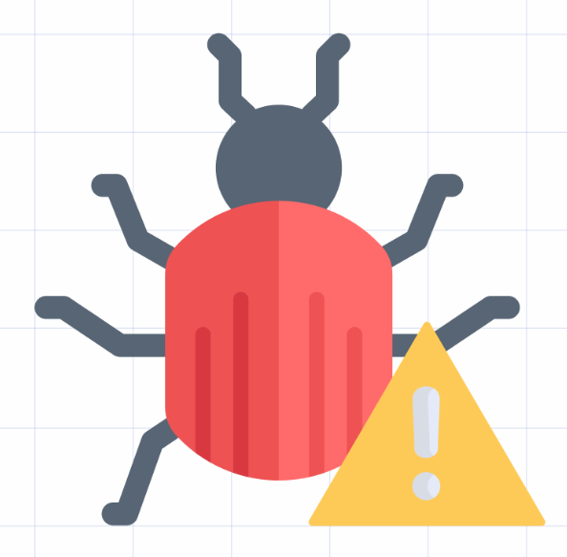
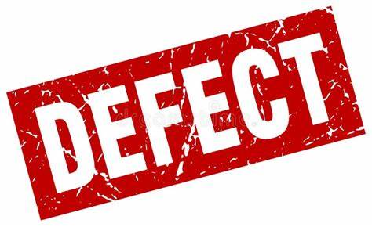
Defects/Bugs
A defect or bug refers to any flaw or issue in the software application that prevents it from functioning as expected.
It occurs when there is a mismatch between the actual behavior and the expected behavior of the software.
The defects are debugged/analysed by triage team and fixed by development team based on their priority and severity of the defect.

Slide 86
Contents in defects
When logging a defect in a tracking tool (e.g., JIRA, Bugzilla), the following details are typically included:
Defect ID
Defect Summary
Description
Severity
Priority
Environment
Module
Test Data
Attachments
Status
Assigned To
Reporter

Slide 87
Severity and Priority
Severity (Impact):
Defines the seriousness of the defect in terms of how it affects the application’s functionality.
It’s typically decided by the tester.
Critical: System crash, data loss, or unavailability of core functionalities.
Major: Major functionality is broken
Minor: Minor issues like spelling errors or slight UI misalignment.
Trivial: Cosmetic issues with no functional impact (e.g., typos).
Priority (Urgency):
Defines how quickly the defect should be addressed.
It’s typically decided by the project manager or product owner.
High Priority: Needs to be fixed immediately; blocking further progress.
Medium Priority: Important but not urgent; can be scheduled in the next sprint/release.
Low Priority: Can be deferred to later releases; doesn’t affect immediate goals.

Slide 88
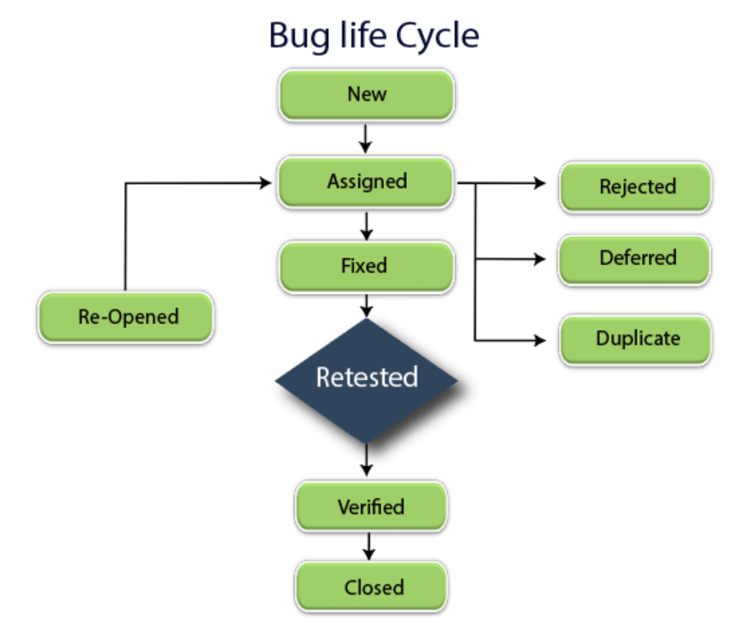

Slide 89
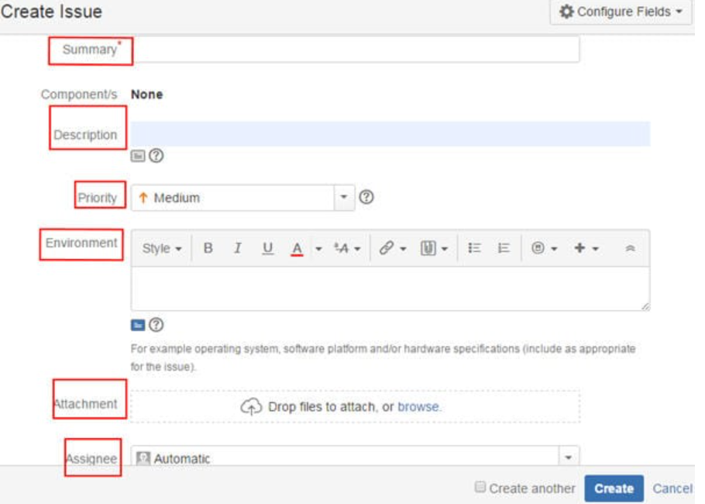

Slide 90
JIRA
JIRA is a popular tool developed by Atlassian, widely used for bug tracking, issue tracking, and project management.
Plan and manage projects using agile methodologies like Scrum and Kanban.
Collaborate effectively by assigning tasks, setting priorities, and monitoring progress.

Slide 91
Benefits of JIRA tool
Centralized collaboration
Transparency
Scalability
Flexibility
Features of JIRA
Issue Tracking
Agile Boards
Customizable Workflows
Reporting and Analytics
Integration: Seamlessly integrates with tools like Confluence, Bitbucket, and GitHub.
Automation: automates the repetitive task

